Slide 1
Deep Learning Based Driver Drowsiness & Vigilance Detecting System
Under the guidance Of:
Dr. Farida Khursheed
Team Members:
Sudhanshu Chaudhary : 2023BECE039
Ishika Sahu : 2023BECE035
Nishant: 2023BECE097

Slide 2
Table Of Contents
Introduction
Problem statement
Objective
Data set
Initial Research Direction
Work done EAR Calculation
Observe EAR Behaviour
Proposed Model
Applications
Reference

Slide 3

Introduction
VISUAL BEHAVIOUR
Signs of reduced vigilance can appear through eye closure, yawning, head movement and facial changes.
DRIVER DROWSINESS
Drowsiness reduces attention and reaction capability, creating a major road-safety concern.
OUR APPROACH
Use video and deep learning to learn relevant visual patterns automatically.

Slide 4
Problem statement
The objective is to develop and evaluate an automated system capable of interpreting a driver's facial behaviour from video and determining whether the driver is Alert, at Low Vigilance or Drowsy. The system should use a camera/video stream as its primary input and should not require physical sensors attached to the driver.

Slide 5
OBJECTIVE
Develop a non-contact video-based driver-state monitoring system.
Automatically learn relevant facial and behavioral patterns from video frames.
Classify the driver as Alert, Low Vigilance or Drowsy.
Capture temporal behavior rather than relying only on single-frame decisions.
Reduce dependence on manually engineered features such as EAR-only rules.
Evaluate generalization on completely unseen participants.
Create a foundation that can later be converted into a real-time monitoring system.

Slide 6

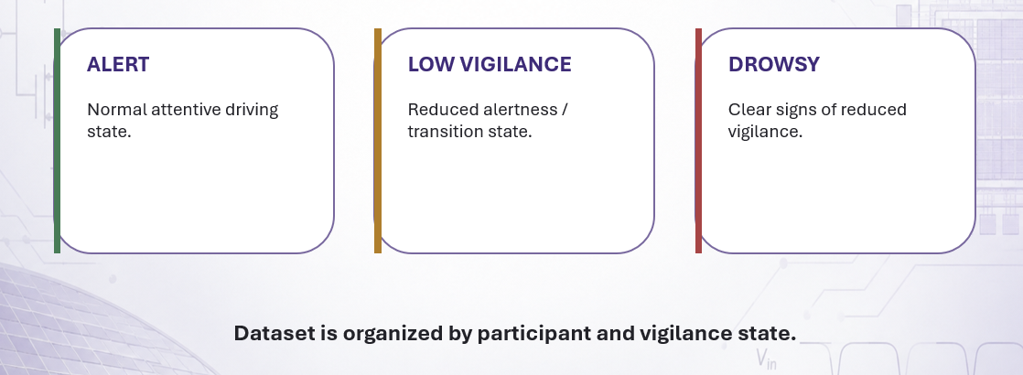
Data Set
UTA Real-Life Drowsiness Dataset (UTA-RLDD), University of Texas at Arlington.

Slide 7
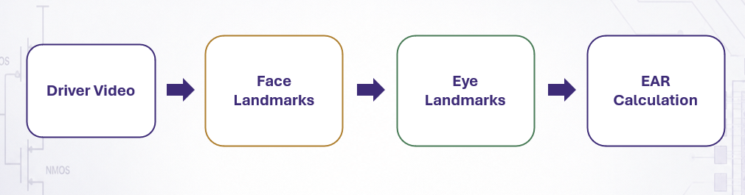
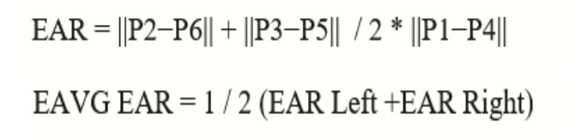
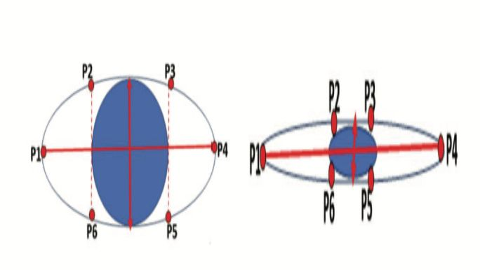
Initial research direction
Formula Used

Slide 8
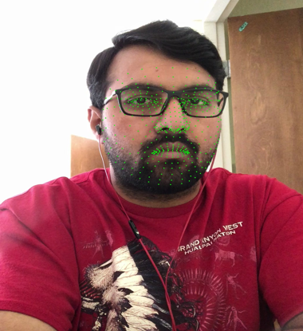
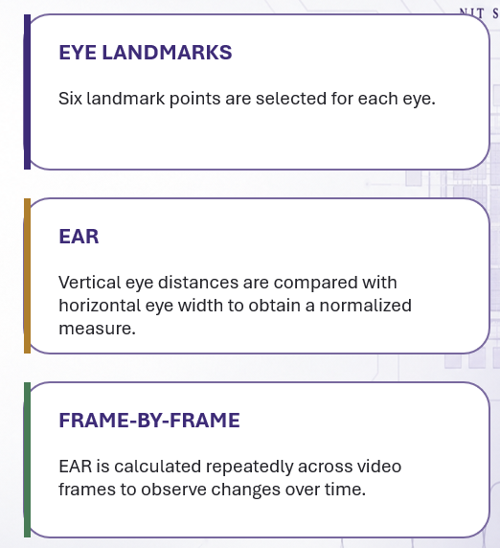
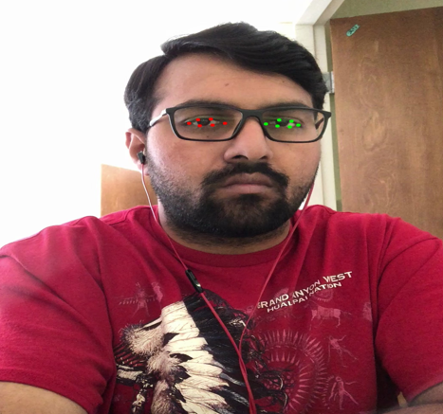
Work done And EAR Calculation

Slide 9
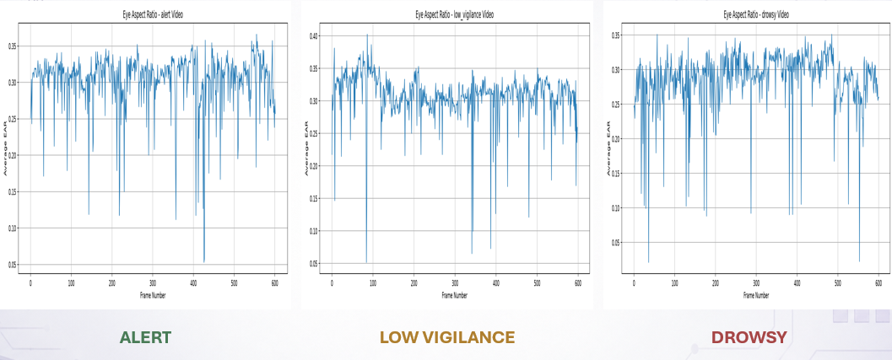
Observed EAR Behaviour
EAR values plotted across video frames
The plots show that eye behaviour changes over time, but the signal is not perfectly clean or sufficient by itself to describe the complete driver state.

Slide 10
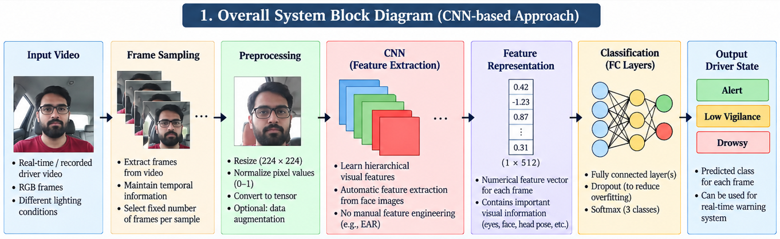
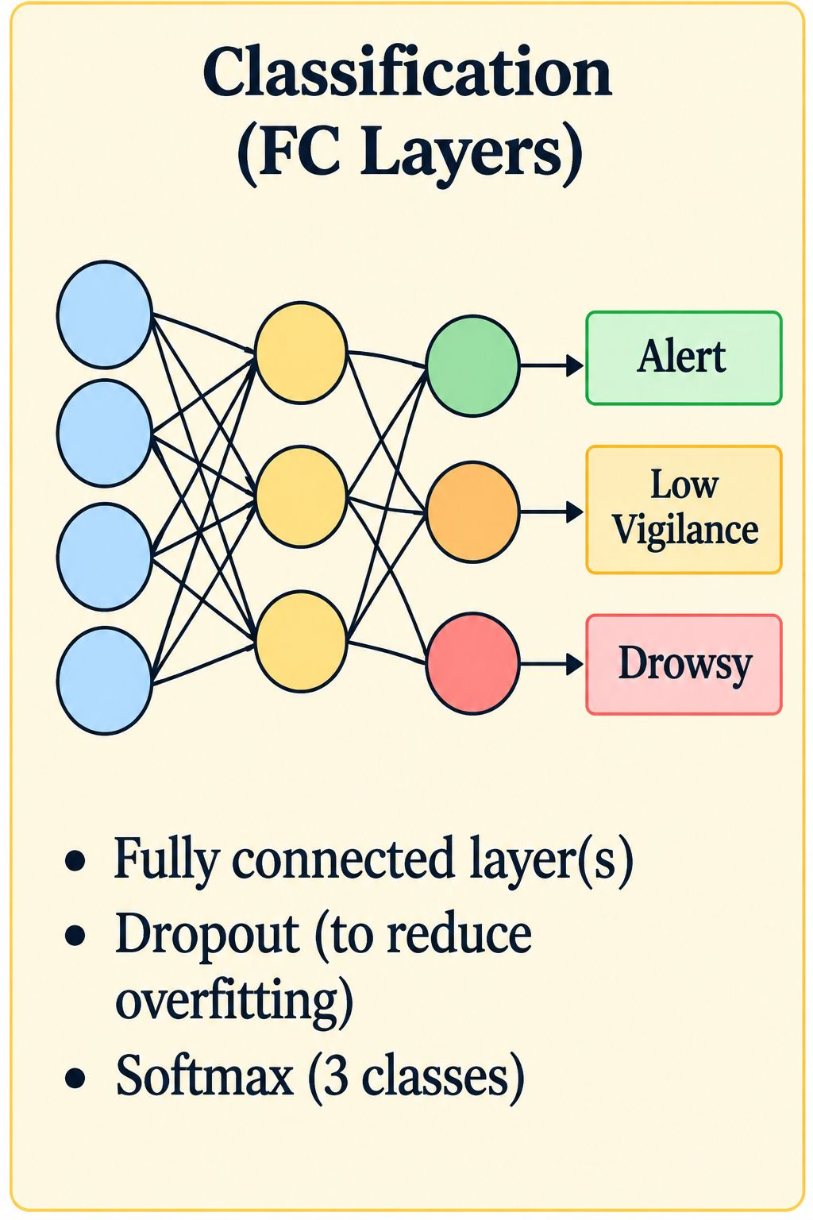
Proposed Model

Slide 11
Application
1. Driver Safety & Accident
Prevention Detects signs of reduced vigilance and can warn the driver before the situation becomes dangerous.
2. Real-Time Driver Monitoring
Can be integrated with an in-car camera to continuously monitor the driver's visual behaviour.
3. Fleet & Commercial Vehicles
Useful for monitoring drivers of buses, trucks, taxis and delivery vehicles, where long driving hours can increase fatigue.
4. Driver Alert / Warning System
The predicted state can trigger an alarm, buzzer or visual warning when drowsiness is detected.
5. Advanced Driver Assistance Systems (ADAS)
Can act as one component of a larger vehicle safety system alongside other driver-monitoring functions.
6. Long-Distance & Night Driving
Particularly useful during situations where drivers are more likely to experience fatigue, such as long highway journeys or night driving.

Slide 12
Reference
Soukupová, T., & Čech, J. (2016). Real-Time Eye Blink Detection using Facial Landmarks.
Ghoddousian, R., Rosenberg, M., & others. A Robust Deep Learning-Based System for Driver Drowsiness Detection.
UTA Real-Life Drowsiness Dataset (UTA-RLDD), University of Texas at Arlington.
OpenCV — Computer Vision Library.
PyTorch — Deep Learning Framework.

